Slide 1
You now work for GRAND DESIGNS
Your job:
To produce a house design, calculate the costs and request the Grand Designs team to build it!

Slide 2
Planning

Slide 3
Objectives and Outcomes
Learning Objective:
Know the purpose of a Gantt chart and be able to use one to plan activities.
Learning Outcomes:
GOOD: Use the Gantt chart template to plan duration of tasks.
BETTER: Use the Gantt chart to accurately and realistically plan the duration of each task.
BEST: Description of your ideal dream house.

Slide 4


Using a Gantt Chart
Imagine you were planning a party . . .
 |  | Weeks
Task | Duration | 1 | 2 | 3 | 4 | 5 | 6 | 7 | 8
Book Venue
Book DJ
Send invitations
Keep a record of guests attending
Buy and prepare food

Slide 5
Planning
Use the Gantt Chart template to plan out how long each of these tasks will take:
Use Sketchup to design a house for a new housing development
Analyse the finances for the project
Produce advertising materials
Produce a presentation for the Grand Designs team
Evaluate the products produced

Slide 6
Extension
Write a description of your dream house, make sure you cover all of the points below.
Appearance
Features
Colours
Rooms
Outside areas
Location

Slide 7
Q&A
What features would your dream house have?
How would the garden look?
How many bedrooms would it have?
What colours would you use?

Slide 8
Using SketchUp

Slide 9
Objectives and Outcomes
Learning Objective:
Understand how to use and combine the tools in SketchUp to create a 3D model of a house.
Learning Outcomes:
GOOD: Create the basic house model by using the guide sheet.
BETTER: Create the house model (including a garden) independently by using the guide sheet with no help from any classmates.
BEST: Create a model of your own house.

Slide 10
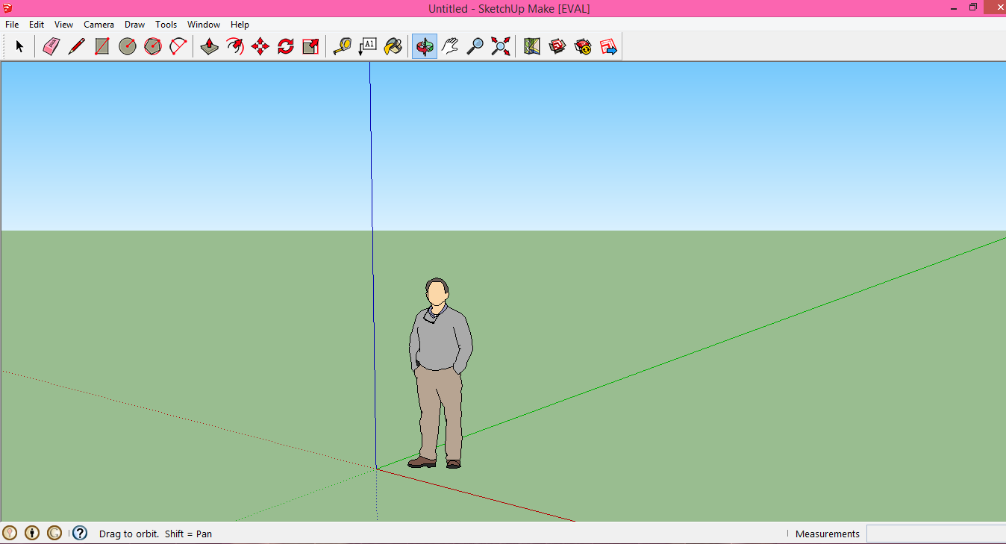
What is SketchUp?
A free 3D modelling tool.
Who has used SketchUp before?

Slide 11
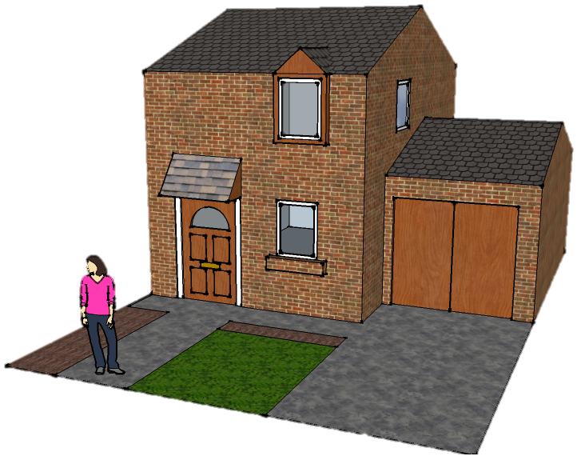
Using SketchUp
Use the guide sheets to independently create a house using SketchUp.
EXTENSION: Have a go at creating your own house. Try to make it as accurate as possible.

Slide 12
How did it go?
What parts were difficult about creating the model?
What parts were easy?
Did you use any tools that weren’t on the sheet?

Slide 13
House Design

Slide 14
Objectives and Outcomes
Learning Objective:
Understand how to use and combine the tools in SketchUp to create and export a model of a house for a given purpose.
Learning Outcomes:
GOOD: Create a model of a suitable holiday home in Kent.
BETTER: Create a model of a house that looks like an appealing holiday home.
BEST: An unusual and unique model that shows an in-depth use of a range of tools.

Slide 15

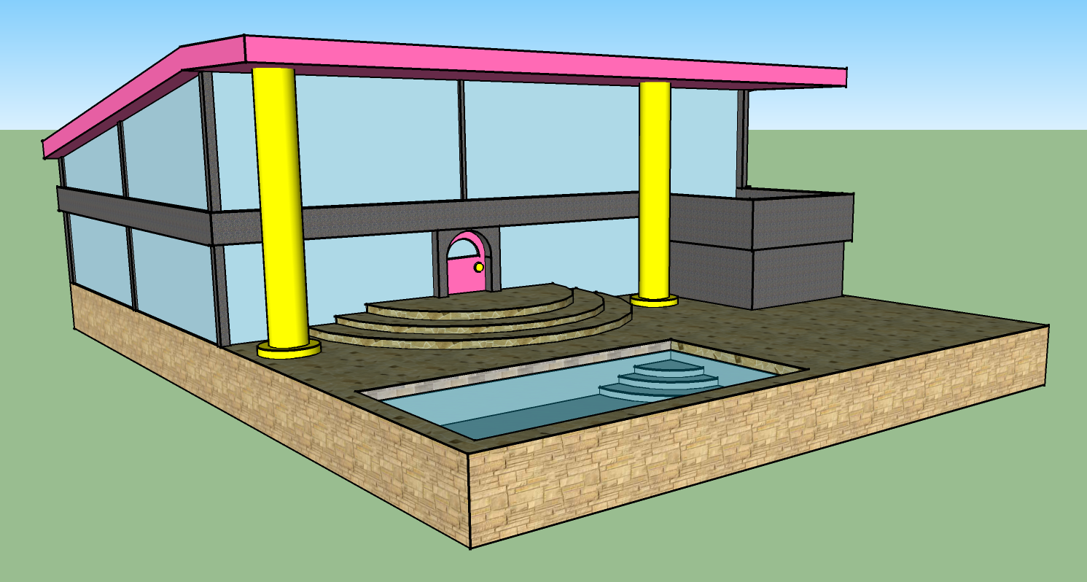
Holiday Home in Kent
What sort of features would a holiday home have?

Slide 16
Holiday Home in Kent
First, decide on your target customer:
Families
Couples
Singles
Then, choose a location in Kent.
Using the skills you’ve learnt so far in SketchUp design a holiday home to be built in Kent as part of a new development by Grand Designs.
Try to make the house look unusual and unique.

Slide 17
How did we do?
Learning Outcomes:
GOOD: Create a model of a suitable holiday home in Kent.
BETTER: Create a model of a house that looks like an appealing holiday home.
BEST: An unusual and unique model that shows an in-depth use of a range of tools.

Slide 18
Finances

Slide 19
Objectives and Outcomes
Learning Objective:
Understand how to use formulas and functions in a spreadsheet to calculate costs.
Learning Outcomes:
GOOD: Use formulas to complete most of the spreadsheet.
BETTER: Accurately use both formulas and functions to complete the spreadsheet.
BEST: Test the spreadsheet by changing some of the values.

Slide 20
Finances
Use the Spreadsheet Help Sheet and the Finances template to calculate the cost of building your house.
EXTENSION: Change the following values in the spreadsheet:
Price of plumbers per hour = £7.50
Number architect’s hours = 120
In a separate Word document explain what you have done and what effect these changes had on the rest of the spreadsheet and why.

Slide 21
What Can You Remember?
What symbol is used for multiplication in spreadsheets?
What function do we use to add up lots of numbers?
Why was it better to use a Spreadsheet for this task than calculating the costs manually?

Slide 22
Presentation

Slide 23
Objectives and Outcomes
Learning Objective:
Understand how to apply design skills in PowerPoint to suit a specific audience.
Learning Outcomes:
GOOD: A PowerPoint presentation that contains most of the specified information.
BETTER: A PowerPoint presentation that contains all of the specified information and suits the target audience.
BEST: One improvement made to the presentation after receiving feedback from a friend.

Slide 24



Example of a bad slide
This is a slide about the simpsons who are my favourite cartoon characters because the are funny and there are lots of characters in it and my favourite character is bart. The simpsons have 5 members in there family, bart, lisa, maggie, homer and marge, bart is the oldest out of all the children and maggie is the youngest and lisa is really brainy. Homer and marge are there parents and they live on evergreen terrace.

Slide 25
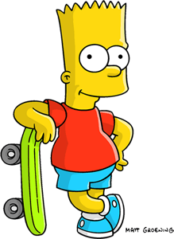
Example of a Good Slide
This is a slide about The Simpsons which is my favourite cartoon show.
The reason The Simpsons is my favourite cartoon is because :
- They are funny
- There are lots of different characters
Bart is my best character because he is always getting up to mischief!

Slide 26
Presentation
Create a PowerPoint presentation to explain to the Grand Designs building team why they should build your house. You must include:
Information about the house to be built (including a labelled picture)
Finances (broken down)
Location
Income
Why it is a good investment
EXTENSION: Ask a friend to review your brochure and make at least one improvement based on the feedback received.

Slide 27
How did we do?
Learning Outcomes:
GOOD: A PowerPoint presentation that contains most of the specified information.
BETTER: A PowerPoint presentation that contains all of the specified information and suits the target audience.
BEST: One improvement made to the presentation after receiving feedback from a friend.

Slide 28
Evaluation

Slide 29
Objectives and Outcomes
Learning Objective:
Understand how to write an evaluation using criteria to make judgements about our work.
Learning Outcomes:
GOOD: An evaluation of each of the pieces of work carried out in this topic.
BETTER: A detailed and thorough evaluation using PEE for each piece of work carried out.
BEST: One piece of work that has been improved based on the suggestions in the evaluation.

Slide 30
Writing a Good Evaluation
Writing a Good Evaluation
Point – State the point you are trying make. What are you talking about?
Evidence – What examples can you show to help make your point? Maybe you could include screenshots?
Explanation – Thoroughly explain the point, including good and bad points where possible.

Slide 31
Evaluating your Work
For each piece of work you have done in this topic (except the GANTT chart) write about the following points:
Explanation of what the task was about
Did you complete it in the time planned? (in the GANTT chart)
How does it suit the target audience?
What parts of the task went well, and why?
What parts of the task could be better, and how?
(All your answers MUST be in full sentences)
EXTENSION: Improve one of the pieces of work using the suggestions you made in your evaluation.

Slide 32
Did we enjoy this topic?
What parts did you like best?
What parts did you like the least?
How could it be made better?

