Slide 1


Creating a Christmas Card with a Wee Mee

Slide 2

Learning Objective
“Learn how to create a Wee Mee Christmas Card in Publisher”.
Write this Learning Objective onto your Self Assessment Sheet.
Tuesday, 02 September 2008

Slide 3

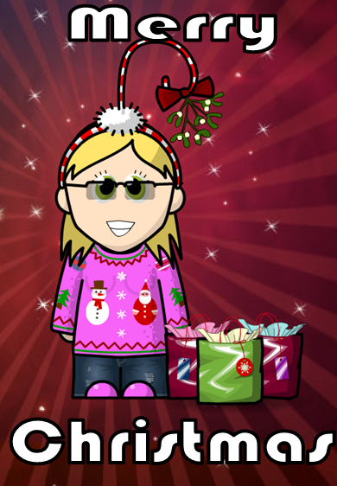
A “Wee Mee” Christmas Card
Greeting goes inside
Learn how to create a Wee Mee Christmas Card in Publisher

Slide 4

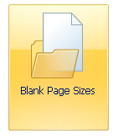
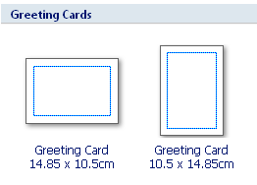
Laying out the Card
Select from the menu.
Scroll down to “Greeting Cards” and select one of the following:
Learn how to create a Wee Mee Christmas Card in Publisher

Slide 5


Tasks
Create a Wee Mee for yourself using:
www.weeworld.com
Zoom in 200% then take a screenshot of your Wee Mee to put onto your Christmas Card.
Paste and crop your Wee Mee to fit onto the front of your card and write your message inside.
Learn how to create a Wee Mee Christmas Card in Publisher

Slide 6

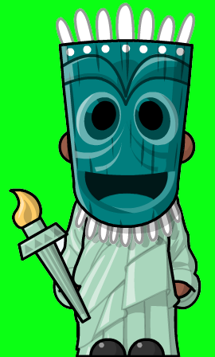
Just for Fun!
Try to make the craziest looking “Wee Mee” you can!
(There will be a prize for the winner!)
Learn how to create a Wee Mee Christmas Card in Publisher

Slide 7

Learning Objective
“Learn how to create a Wee Mee Christmas Card in Publisher”.
Put ☺ or ☹ onto your Self Assessment sheet to show whether or not you have achieved today’s learning objective.
Tuesday, 02 September 2008

Slide 8
Merry Christmas
Have a happy and safe Christmas holiday!
Tuesday, 02 September 2008

