Slide 1

Writing a Business Letter

Slide 2
Learning Objective
“Learn how to lay out a formal business letter using Microsoft Word”.
Write this Learning Objective onto your Self Assessment Sheet.
Saturday, 30 August 2008

Slide 3

Who is your Target Audience?
    Child
    Teenager
    Adult
    Elderly Person
Learn how to lay out a formal business letter using Microsoft Word

Slide 4
A Formal Business Letter
The top of your document should look like this:
Your Name
Your Road
YOUR TOWN
Kent
Your Postcode
30 August 2008
Mr Somers
Hartsdown Technology College
George V Avenue
MARGATE
Kent
CT9 5RE
Dear Mr Somers
Learn how to lay out a formal business letter using Microsoft Word

Slide 5
Task
Write a formal business letter to Mr Somers using Microsoft Word.
In your letter give SENSIBLE suggestions on improvements you would like to see in the College.
Learn how to lay out a formal business letter using Microsoft Word

Slide 6
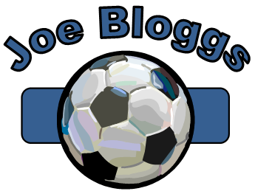
Extension Task
Select a suitable piece of clipart and combine it with WordArt and an auto shape to make a logo for the top of your letter. Here is an example:
Learn how to lay out a formal business letter using Microsoft Word

Slide 7
Extension Task Outcome
The finished product:
Your Name
Your Road
YOUR TOWN
Kent
Your Postcode
30 August 2008
Mr Somers
Hartsdown Technology College
George V Avenue
MARGATE
Kent
CT9 5RE
Dear Mr Somers
Learn how to lay out a formal business letter using Microsoft Word

Slide 8
Learning Objective
“Learn how to lay out a formal business letter using Microsoft Word”.
Put ☺ or ☹ onto your Self Assessment sheet to show whether or not you have achieved today’s learning objective.
Saturday, 30 August 2008

