Slide 1

Creating an Interactive Quiz

Slide 2
Learning Objective
“Learn how to insert hyperlinks into a PowerPoint presentation”.
Write this Learning Objective onto your Self Assessment Sheet.
Wednesday, 04 November 2009

Slide 3
Hyperlink
A hyperlink is an object that links to somewhere else.
This could be a web page or a different slide.
This hyperlink takes me to a different slide.
Learn how to insert hyperlinks into a PowerPoint presentation

Slide 4
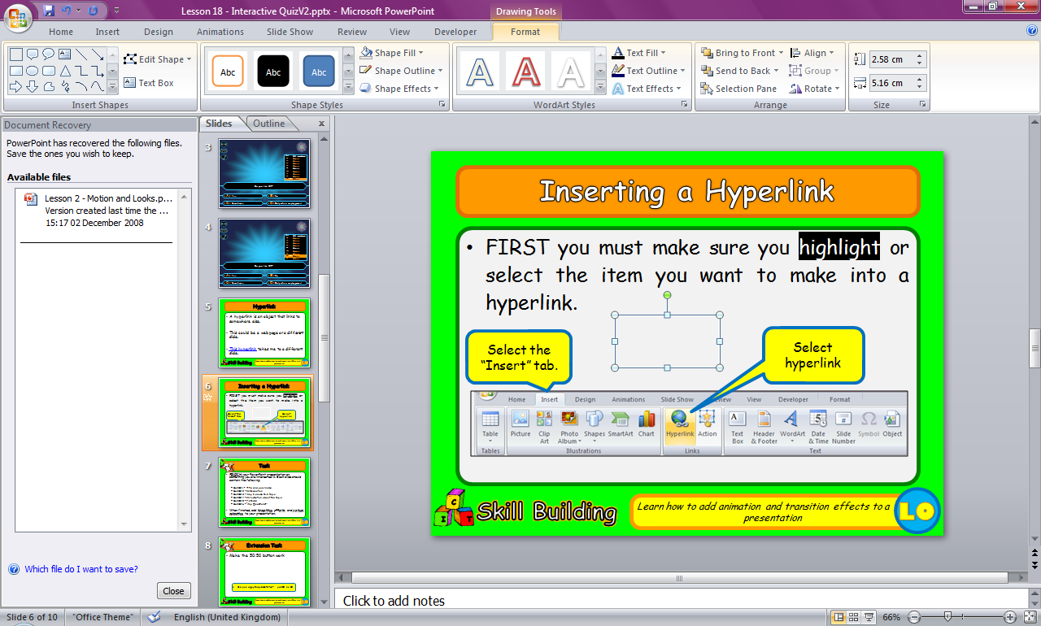
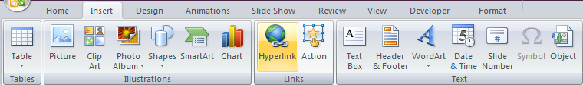
Inserting a Hyperlink
FIRST highlight or select the item you want to make into a hyperlink.
Select the “Insert” tab.
Select hyperlink
Learn how to insert hyperlinks into a PowerPoint presentation

Slide 5

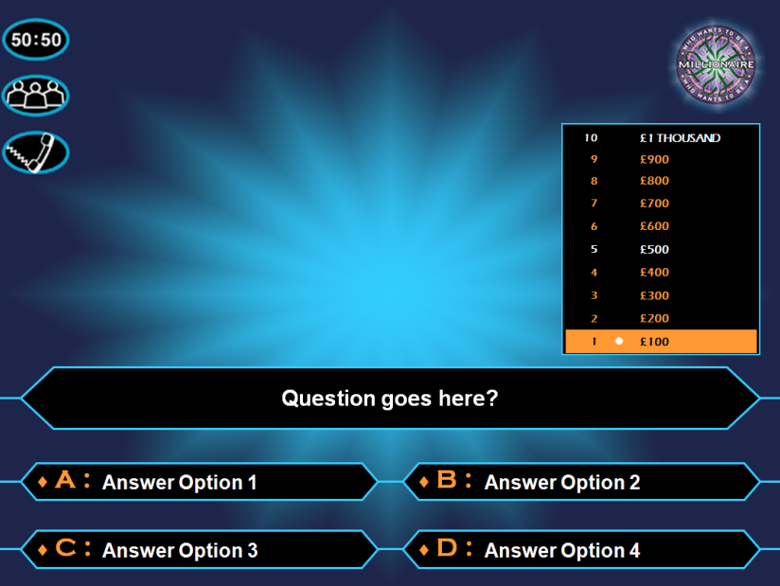

This Lesson
You are going to make your own “Who Wants to be a Millionaire” Game.
Learn how to insert hyperlinks into a PowerPoint presentation

Slide 6
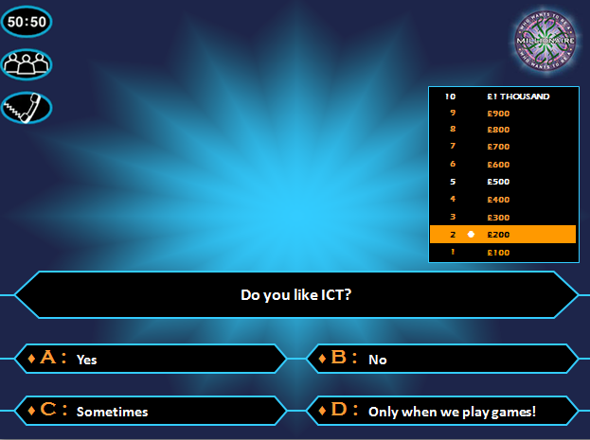
Task
Open the PowerPoint called: “Lesson 19 – MILLIONAIRE RESOURCE”
Save this in your ICT folder.
Add your own questions THEN hyperlink the answers so they go to the right places. (The first one has been done for you)
Learn how to insert hyperlinks into a PowerPoint presentation

Slide 7
Extension Task
See if you can make the 50:50 lifeline button work. You will need to:
  Copy and paste the current question then delete two of the wrong answers.
  You will then need to hyperlink the 50:50 button to this new slide.
Learn how to insert hyperlinks into a PowerPoint presentation

Slide 8
Learning Objective
“Learn how to insert hyperlinks into a PowerPoint presentation”.
Put ☺ or ☹ onto your Self Assessment sheet to show whether or not you have achieved today’s learning objective.
Wednesday, 04 November 2009

Slide 9
A Different Slide
This is a button that’s been used as a hyperlink and will take me back again:
Click Me!
Learn how to insert hyperlinks into a PowerPoint presentation

