Slide 1

Creating a Calendar

Slide 2
Learning Objective
“Learn how to create a calendar using a template in Publisher”.
Write this Learning Objective onto your Self Assessment Sheet.
Monday, 22 November 2010

Slide 3
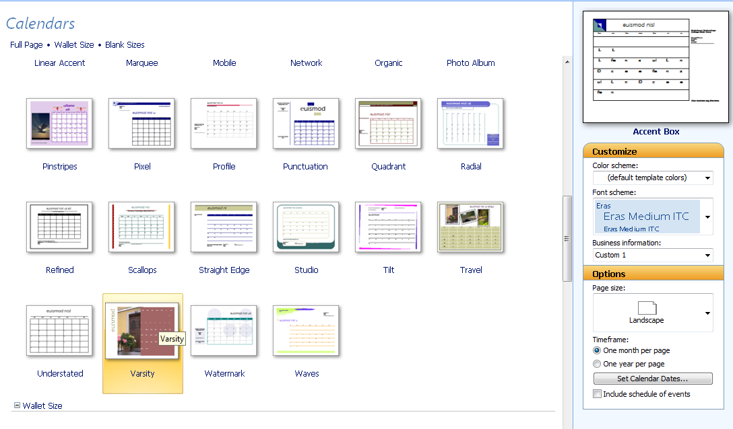
Using the Calendar Templates
Choose a calendar that has space for pictures.
You MUST set the calendar dates as :
Start – January 2009
End – December 2009
Learn how to create a calendar using a template in Publisher

Slide 4
Task
Create a calendar for 2011
Use Clipart or the Internet to change the pictures in the calendar.
Learn how to create a calendar using a template in Publisher

Slide 5
Extension Task
Create a new calendar for a friend or family member (make sure you use pictures of things they will like!)
Learn how to create a calendar using a template in Publisher

Slide 6
Learning Objective
“Learn how to create a calendar using a template in Publisher”.
Put ☺ or ☹ onto your Self Assessment sheet to show whether or not you have achieved today’s learning objective.
Monday, 22 November 2010

