Slide 1
Sensing and Variables

Slide 2
Learning Objective
“Learn how to sense events and keep score”.
Write this Learning Objective onto Page 1 of your workbook.
Wednesday, 05 May 2010

Slide 3
Sensing
Sensing can be used to detect when something has happened in a game. Like touch in this example:
Is shark touching fish?
No
Yes
Add to score.
Learn how to sense events and keep score.

Slide 4
Variables
Variables are used to store data.
In order for a game to “remember” what a players score is it must store it in a variable.
Think of variables as boxes to store data which can be retrieved later.
PLAYER NAMES
SCORE
LIFE
Learn how to sense events and keep score

Slide 5
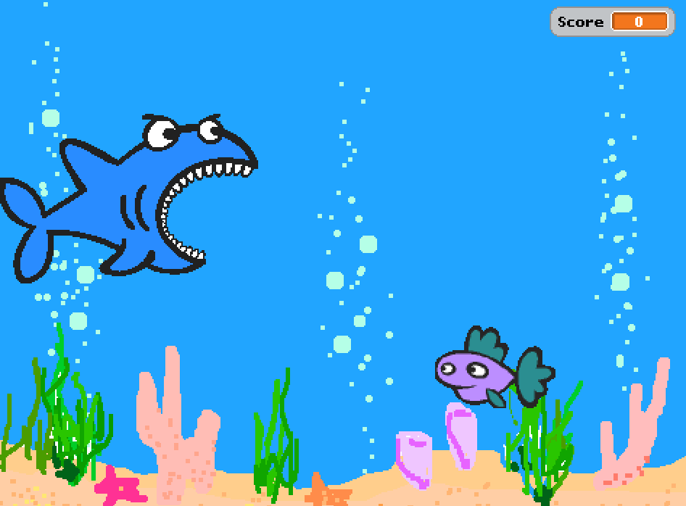
The Game
Use the instructions on page 10 of your workbooks to create this Shark Attack game:
Score shown here.
Shark will move up and down using  cursor keys.
Fish will start in a different place each time.
Learn how to sense events and keep score

Slide 6
Extension Task
Make your game better by adding some more features:
Change the sharks costume so it closes it’s mouth to eat the fish.
Add a GAME OVER stage to be displayed if the fish doesn’t get eaten.
Learn how to sense events and keep score

Slide 7
Learning Objective
“Learn how to sense events and keep score”.
Put ☺ or ☹ onto your Self Assessment page to show whether or not you have achieved today’s learning objective.
Wednesday, 05 May 2010

Slide 8
What can you remember?
What do X and Y mean when talking about the position of a sprite?
What is a variable used for?
What does broadcast mean?
Learn how to sense events and keep score

