Slide 1

Creating a quiz in Excel

Slide 2
Learning Objective
“Learn how to create a quiz using the IF function in Microsoft Excel”.
Write this Learning Objective onto your Self Assessment Sheet.
Monday, 25 January 2010

Slide 3
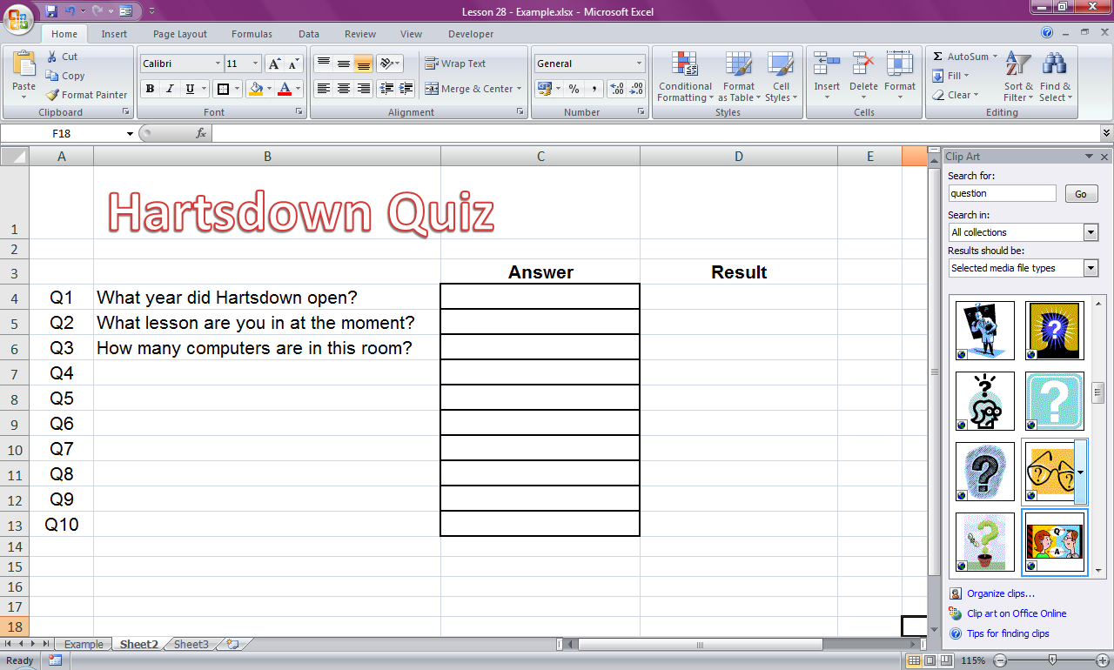
Laying out the Quiz
Title at the top
Questions
Space for answers
Space to display results
Learn how to create a quiz using the IF function in Microsoft Excel

Slide 4
Tasks
Create a 5 question quiz laid out like the one below for a topic of your choice (leave the answer boxes blank).
Learn how to create a quiz using the IF function in Microsoft Excel

Slide 5
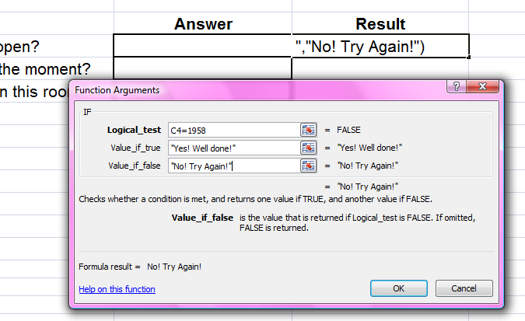
Tasks
Insert IF statements so the quiz works when the answers are inserted.
Response if answer is correct
Check the answer here. Words must have “speech marks” around them.
Response if answer is wrong
Learn how to create a quiz using the IF function in Microsoft Excel

Slide 6
Extension Task
Use the guide sheet called “Conditional Formatting” to make results cells turn green if the answer is correct or red if it’s wrong.
Learn how to create a quiz using the IF function in Microsoft Excel

Slide 7
Learning Objective
“Learn how to create a quiz using the IF function in Microsoft Excel”.
Put ☺ or ☹ onto your Self Assessment sheet to show whether or not you have achieved today’s learning objective.
Monday, 25 January 2010

