Slide 1

Animation Frames

Slide 2
Learning Objective
“Learn how to create animation frames in PowerPoint”.
Write this Learning Objective onto your Self Assessment Sheet.
Sunday, 30 January 2011

Slide 3
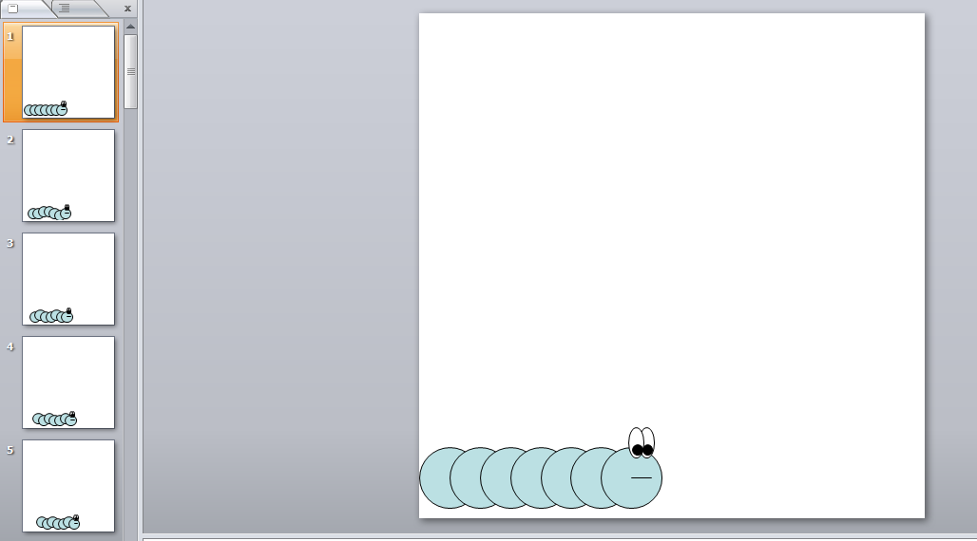
Creating Frames in PowerPoint
Use auto shapes to create pictures
Each slide is a frame – picture moved slightly in each one
Learn how to create animation frames in PowerPoint

Slide 33
Did you miss that?
Play again
Learn how to create animation frames in PowerPoint

Slide 34
Automatic Timing
Change timing here. You’ll have to try different timings - 00:00.07 works well for the Worm example.
Apply the settings to all slides here.
Learn how to create animation frames in PowerPoint

Slide 35
Task
Create the frames needed for a simple animation in PowerPoint.
Change the timings so the animation plays automatically.
Learn how to create animation frames in PowerPoint

Slide 36
Extension Task
Does your animation run smoothly?
Try adding some more frames to ensure the animation is as smooth as possible.
Add characters with speech bubbles to create a story.
Learn how to create animation frames in PowerPoint

Slide 37
Learning Objective
“Learn how to create animation frames in PowerPoint”.
Put ☺ or ☹ onto your Self Assessment sheet to show whether or not you have achieved today’s learning objective.
Sunday, 30 January 2011

