Slide 1

Creating a Presentation

Slide 2
Learning Objective
“Learn how to add animation and transition effects to a presentation”.
Write this Learning Objective onto your Self Assessment Sheet.
Monday, 14 July 2008

Slide 3
Transitions & Animations
A Transition Effect is the way a slide appears onto the screen (like you just saw).
Custom animation is the way you make text and pictures move in a PowerPoint slide like this:
Learn how to add animation and transition effects to a presentation

Slide 4
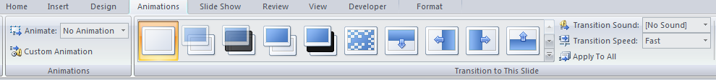
The Animation Ribbon
Select Custom Animation to move individual objects on the slide.
Choose from the selection of Transition effects.
Learn how to add animation and transition effects to a presentation

Slide 5
Task
FINISH your PowerPoint presentation on something you are interested in. Each slide should contain the following:
SLIDE 1 – Title and your name
SLIDE 2 - Introduction
SLIDE 3 - Why I chose this topic
SLIDE 4 – Information about the topic
SLIDE 5 – Pictures
SLIDE 6 – “Any Questions?”
When finished, add transition effects and custom animation to your presentation.
Learn how to add animation and transition effects to a presentation

Slide 6
Extension Task
Create a questionnaire in Word to give out to other students to find out what they thought of your presentation.
Questions should be laid out like this:
Did you enjoy the presentation? yes ◻ no ◻
Learn how to add animation and transition effects to a presentation

Slide 7
Learning Objective
“Learn how to add animation and transition effects to a presentation”.
Put ☺ or ☹ onto your Self Assessment sheet to show whether or not you have achieved today’s learning objective.
Monday, 14 July 2008

