Slide 1

Creating a Timetable

Slide 2
Learning Objective
“Learn how to create a timetable in Microsoft Word”.
Write this Learning Objective onto your Self Assessment Sheet.
Wednesday, 16 September 2009

Slide 3
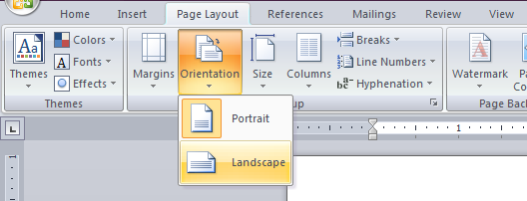
Task
Open Microsoft Word and change the page layout to LANDSCAPE:
Put the title My Timetable at the top.
From the INSERT tab insert a table with 6 columns and 8 rows.
Learn how to create a timetable in Microsoft Word

Slide 4
Task
Add the headings to your table to make it look like this:
Now add your lessons to the timetable.
Lesson | Monday | Tuesday | Wednesday | Thursday | Friday
1
2
3
4
5
6
7
Learn how to create a timetable in Microsoft Word

Slide 5
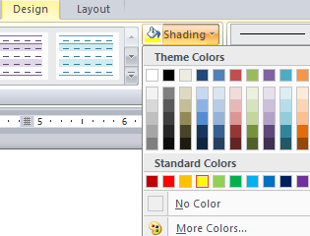
Extension Task
Colour code your timetable for different subjects by using the SHADING tool:
Once you’ve done this add clipart to the timetable to represent each of your subjects.
Learn how to create a timetable in Microsoft Word

Slide 6
Learning Objective
“Learn how to create a timetable in Microsoft Word”.
Put ☺ or ☹ onto your Self Assessment sheet to show whether or not you have achieved today’s learning objective.
Wednesday, 16 September 2009

