Slide 1

Creating a Presentation

Slide 2
Learning Objective
“Learn how to use PowerPoint with a suitable design to create a presentation”.
Write this Learning Objective onto your Self Assessment Sheet.
Monday, 14 July 2008

Slide 3


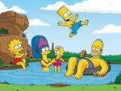
Example of a bad slide
This is a slide about the simpsons who are my favourite cartoon characters because the are funny and there are lots of characters in it and my favourite character is bart

Slide 4
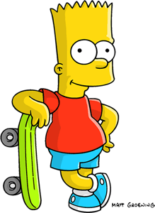
Example of a Good Slide
This is a slide about The Simpsons which is my favourite cartoon show.
The reason The Simpsons is my favourite cartoon is because :
- They are funny
- There are lots of different characters
Bart is my best character because he is always getting up to mischief!

Slide 5
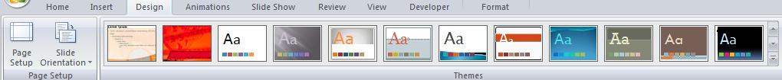
Design Styles
Lots of different designs to choose from:
Keep to the same colours and fonts throughout!
Learn how to use PowerPoint with a suitable design to create a presentation

Slide 6
Task
Create a PowerPoint presentation on something you are interested in (ie, hobby, sports team, celebrity, film/TV programme). Each slide should contain the following:
SLIDE 1 – Title and your name
SLIDE 2 - Introduction
SLIDE 3 - Why I chose this topic
SLIDE 4 – Information about the topic
SLIDE 5 – Pictures
SLIDE 6 – “Any Questions?”
Learn how to use PowerPoint with a suitable design to create a presentation

Slide 7
Next Lesson . . .
. . . you will be finishing your presentation and adding animation and transition effects.
Learn how to use PowerPoint with a suitable design to create a presentation

Slide 8
Learning Objective
“Learn how to use PowerPoint with a suitable design to create a presentation”.
Put ☺ or ☹ onto your Self Assessment sheet to show whether or not you have achieved today’s learning objective.
Monday, 14 July 2008

