Slide 1

Collating Data in Excel

Slide 2
Learning Objective
“Learn how to collate data using Microsoft Excel”.
Write this Learning Objective onto your Self Assessment Sheet.
Thursday, 19 February 2009

Slide 3
Results of a Survey
Your job will be to put the results of a survey into an Excel spreadsheet and create graphs from the data.
Learn how to collate data using Microsoft Excel

Slide 4
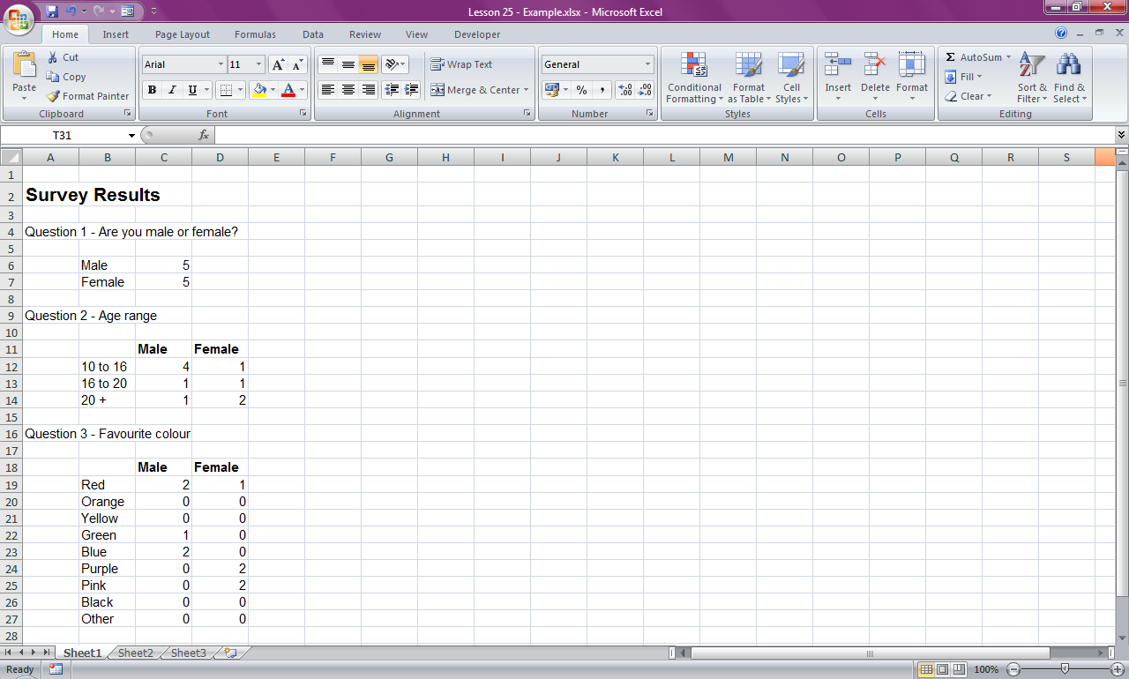
Laying out the Spreadsheet
Summary of each question.
Answers to go in columns under male and female headings.
Learn how to collate data using Microsoft Excel

Slide 5
Task
Create a spreadsheet laid out like the one below to record all of the results from the survey:
Learn how to collate data using Microsoft Excel

Slide 6
Extension Task
Customise your spreadsheet by adding borders and colours to make it look more appealing.
Learn how to collate data using Microsoft Excel

Slide 7
Learning Objective
“Learn how to collate data using Microsoft Excel”.
Put ☺ or ☹ onto your Self Assessment sheet to show whether or not you have achieved today’s learning objective.
Thursday, 19 February 2009

