Slide 1

Publisher Tools

Slide 2
Starter
Complete the Publisher Starter Worksheet by filling in the labels using the words at the bottom of the sheet.
Thursday, 19 February 2009

Slide 3
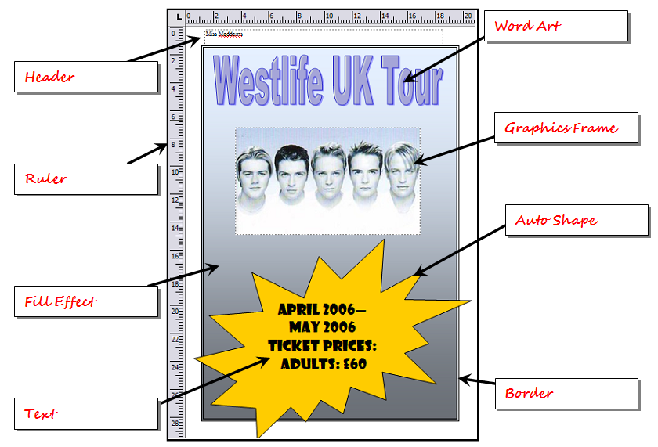
Starter Answers
Thursday, 19 February 2009

Slide 4
Learning Objective
“Learn how to use the autoshape, border, flip and crop tools in Publisher”.
Write this Learning Objective onto your Self Assessment Sheet.
Thursday, 19 February 2009

Slide 5
Task 1
Open the poster on SharePoint called:
  “Lesson 1 – STUDENT RESOURCE”
Crop the picture on the poster and use the tools in Publisher to make the poster look EXACTLY like the one you’ve been given.
There will be a prize for the person(s) whose poster looks MOST LIKE the one given to them!
Learn how to create a poster using Microsoft Publisher

Slide 6
Task 2
Print your poster
Now give it to the person next to you for them to play “spot the difference” with the original.
Circle as many differences as possible on your partners work.
Learn how to use the autoshape, border, flip and crop tools in Publisher

Slide 7
Extension Task
Go back to the poster you created in Publisher and make the changes circled by your partner.
Learn how to use the autoshape, border, flip and crop tools in Publisher

Slide 8
Learning Objective
“Learn how to use the autoshape, border, flip and crop tools in Publisher”.
Put ☺ or ☹ onto your Self Assessment sheet to show whether or not you have achieved today’s learning objective.
Thursday, 19 February 2009

