Slide 1

Creating a Multiplication Square

Slide 2
Learning Objective
“Learn how to use multiplication formulas in a spreadsheet”.
Write this Learning Objective onto your Self Assessment Sheet.
Thursday, 19 February 2009

Slide 3
Multiplication Square
X | 1 | 2 | 3 | 4 | 5 | 6 | 7 | 8 | 9 | 10
1 | 1 | 2 | 3 | 4 | 5 | 6 | 7 | 8 | 9 | 10
2 | 2 | 4 | 6 | 8 | 10 | 12 | 14 | 16 | 18 | 20
3 | 3 | 6 | 9 | 12 | 15 | 18 | 21 | 24 | 27 | 30
4 | 4 | 8 | 12 | 16 | 20 | 24 | 28 | 32 | 36 | 40
5 | 5 | 10 | 15 | 20 | 25 | 30 | 35 | 40 | 45 | 50
6 | 6 | 12 | 18 | 24 | 30 | 36 | 42 | 48 | 54 | 60
7 | 7 | 14 | 21 | 28 | 35 | 42 | 49 | 56 | 63 | 70
8 | 8 | 16 | 24 | 32 | 40 | 48 | 56 | 64 | 72 | 80
9 | 9 | 18 | 27 | 36 | 45 | 54 | 63 | 72 | 81 | 90
10 | 10 | 20 | 30 | 40 | 50 | 60 | 70 | 80 | 90 | 100
Learn how to use multiplication formulas in a spreadsheet.

Slide 4
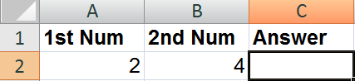
Multiplication Formulas
In spreadsheets the times symbol is *
So 2 x 2 = 4 looks like . . .
2 * 2 = 4
So the FORMULA to work out the answer here is:
=A2*B2
Learn how to use multiplication formulas in a spreadsheet.

Slide 5
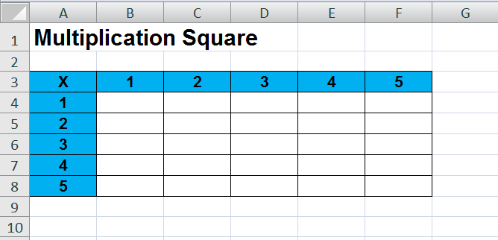
Task
Create a spreadsheet that looks like this:
Now insert FORMULAS to calculate all of the times tables up to 5x5
Learn how to use multiplication formulas in a spreadsheet.

Slide 6
Extension Task
Extend your spreadsheet so it calculates up to the ten times tables.
Learn how to use multiplication formulas in a spreadsheet.

Slide 7
Learning Objective
“Learn how to use multiplication formulas in a spreadsheet”.
Put ☺ or ☹ onto your Self Assessment sheet to show whether or not you have achieved today’s learning objective.
Thursday, 19 February 2009

