Slide 1
Introduction to Flowcharts

Slide 2
Learning Objective
“Learn how to recognise different flowchart symbols and how to put them together”.
Write this Learning Objective onto Page 1 of your workbook.
Friday, 20 February 2009

Slide 3
Sequences of Instructions
When completing a task instructions must be followed in order:
A SEQUENCE
How would you explain to an alien how to make a cheese sandwich?
Learn how to recognise different flowchart symbols and how to put them together

Slide 4
The Cheese Sandwich
Take two slices of bread
Take butter and cheese out of the fridge
Eat
Butter the bread
Cut in half
Put slices of cheese on the bread
Learn how to recognise different flowchart symbols and how to put them together

Slide 5
How Things Work
All everyday machines work by following a set of instructions.
Here’s a toaster –
What instructions do you think it needs to follow?
Learn how to recognise different flowchart symbols and how to put them together

Slide 6
The Toaster
Check temperature setting
Heat the bread
Check toast is hot enough
Pop up toast once cooked
Learn how to recognise different flowchart symbols and how to put them together

Slide 7
Flowcharts
Sequences of instructions can be broken down using flowcharts.
These are the symbols:
= Start/Stop
= Process
= Input/Output
= Decision
Learn how to recognise different flowchart symbols and how to put them together

Slide 8
Back to the Toaster
Check temperature setting
This is a Loop – instructions that repeat over and over again.
Heat bread
Is toast cooked?
No
Yes
Pop up toast
Learn how to recognise different flowchart symbols and how to put them together

Slide 9

Introduction to Task 1
R.O.B.B.O the Robot is not working properly as all his instructions have been mixed up!
You will need to put them in order to make him work correctly!
Learn how to recognise different flowchart symbols and how to put them together

Slide 10
Task 1
Cut out page 2 from your workbooks.
Now cut out each of the flowchart symbols around the dotted lines - - - - -
Glue all the pieces onto the page 4 in order and draw the arrows to make R.O.B.B.O work correctly.
Learn how to recognise different flowchart symbols and how to put them together

Slide 11
Task 1 Answer
Start
Move Forward
Is there an obstacle?
No
Yes
Turn left 90º
Learn how to recognise different flowchart symbols and how to put them together

Slide 12
Task 2
On page 5 draw a flowchart to represent the instructions for making a cup of coffee.
Make sure you use the correct symbols:
= Start/Stop
= Process
= Input/Output
= Decision
Learn how to recognise different flowchart symbols and how to put them together

Slide 13
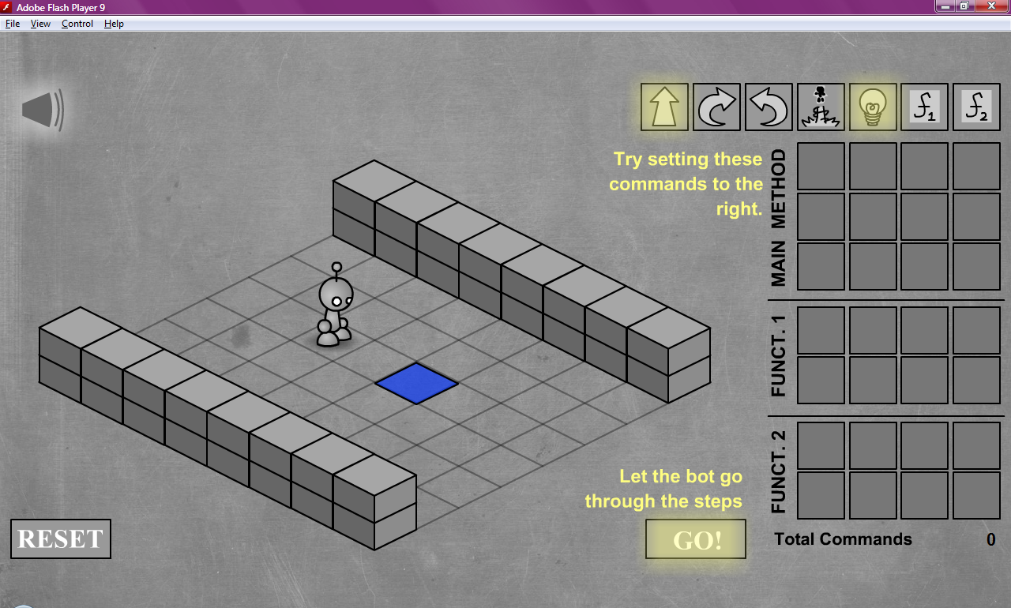
Extension Task
Play the Light Bot Game – make the robot move to the blue square and turn the light on.
Drag and drop the commands onto the MAIN METHOD area.
Learn how to recognise different flowchart symbols and how to put them together

Slide 14
What can you remember?
What are these symbols called?
Learn how to recognise different flowchart symbols and how to put them together

Slide 15
Learning Objective
“Learn how to recognise different flowchart symbols and how to put them together”.
Put ☺ or ☹ onto your Self Assessment page to show whether or not you have achieved today’s learning objective.
Friday, 20 February 2009

