Slide 1
Finishing the Virtual Pet

Slide 2
Learning Objective
“Learn how to add features to a game in Scratch to make it better”.
Write this Learning Objective onto Page 1 of your workbook.
Friday, 20 February 2009

Slide 3
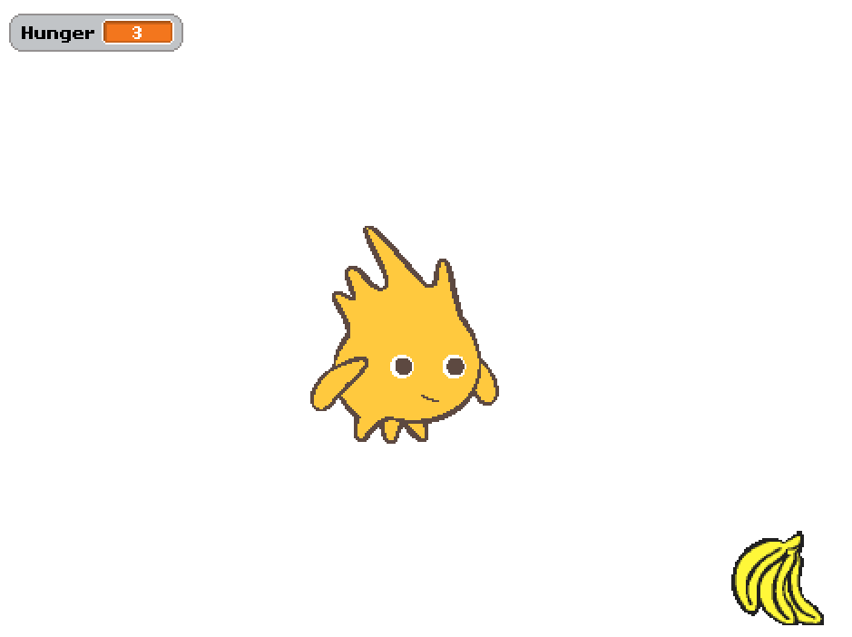
Last Lesson
You made a basic virtual pet using Scratch.
Learn how to add features to a game in Scratch to make it better

Slide 4
Finishing the Game
To finish your game you will need to add the following:
Health
Happiness
Appearance
Intelligence
Turn to Page 17 of your workbook for an explanation of each point.
There will be a prize for the best and most imaginative virtual pet in the class!
Learn how to add features to a game in Scratch to make it better

Slide 5
Peer Assessment
Swap seats and workbooks with the person next to you.
Play your partners Virtual Pet game and complete Page 18 of their workbook.
Learn how to add features to a game in Scratch to make it better

Slide 6
Learning Objective
“Learn how to add features to a game in Scratch to make it better”.
Put ☺ or ☹ onto your Self Assessment page to show whether or not you have achieved today’s learning objective.
Friday, 20 February 2009

Slide 7
What can you remember?
Why is it important to add as many features as possible into a game?
Why is it a good idea to get somebody else to try out your games?
Learn how to add features to a game in Scratch to make it better

