Slide 1
Creating a Virtual Pet

Slide 2
Learning Objective
“Learn how to, independently, make a virtual pet in Scratch”.
Write this Learning Objective onto Page 1 of your workbook.
Friday, 20 February 2009

Slide 3
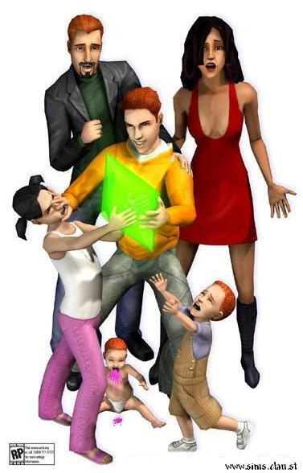
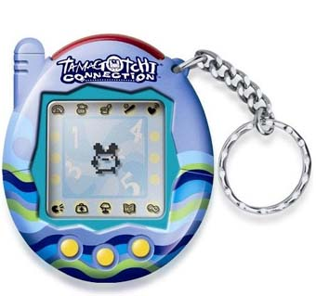
Virtual Pets
A simulation game where the goal is to look after a creature/animal to keep it alive.
Learn how to, independently, make a virtual pet in Scratch

Slide 4
Your Own Virtual Pet
Create a Virtual Pet using Scratch. There is some help on page 16 of your workbooks to get you started.
The game will need to include:
A variable (starting at 0) to store Hunger. This will go up every 30 seconds.
If Hunger gets up to 10 the pet will die.
Learn how to, independently, make a virtual pet in Scratch

Slide 5
Extension Task
Try adding the following features to your game:
Aging – make your pet get bigger as time passes.
Make the pet change into a ghost and float off the screen when it dies.
Add a variable for health which will go down over time and if it’s not fed often enough.
Learn how to, independently, make a virtual pet in Scratch

Slide 6
Learning Objective
“Learn how to, independently, make a virtual pet in Scratch”.
Put ☺ or ☹ onto your Self Assessment page to show whether or not you have achieved today’s learning objective.
Friday, 20 February 2009

Slide 7
What can you remember?
What do we use to store the pets’ hunger?
How would you get the pet to change into a ghost and float off the screen?
Learn how to, independently, make a virtual pet in Scratch

