Slide 1

Creating a Brochure

Slide 2
Learning Objective
“Learn how to create a brochure using Microsoft Publisher”.
Write this Learning Objective onto your Self Assessment Sheet.
Monday, 08 November 2010

Slide 3

Internet Safety
Learn how to create a brochure using Microsoft Publisher

Slide 4
What are the Risks?
Paedophiles
People lying online
Bullying
Viruses and pop-ups
Seeing nasty pictures
Learn how to create a brochure using Microsoft Publisher

Slide 5


What to Remember
Once you put a picture or video online it’s impossible to get it back
It’s important to trust your instincts
It’s never to late to report
Learn how to create a brochure using Microsoft Publisher

Slide 6
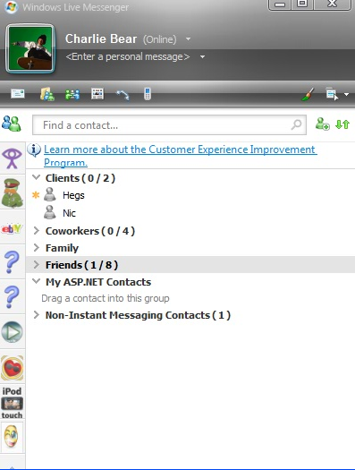
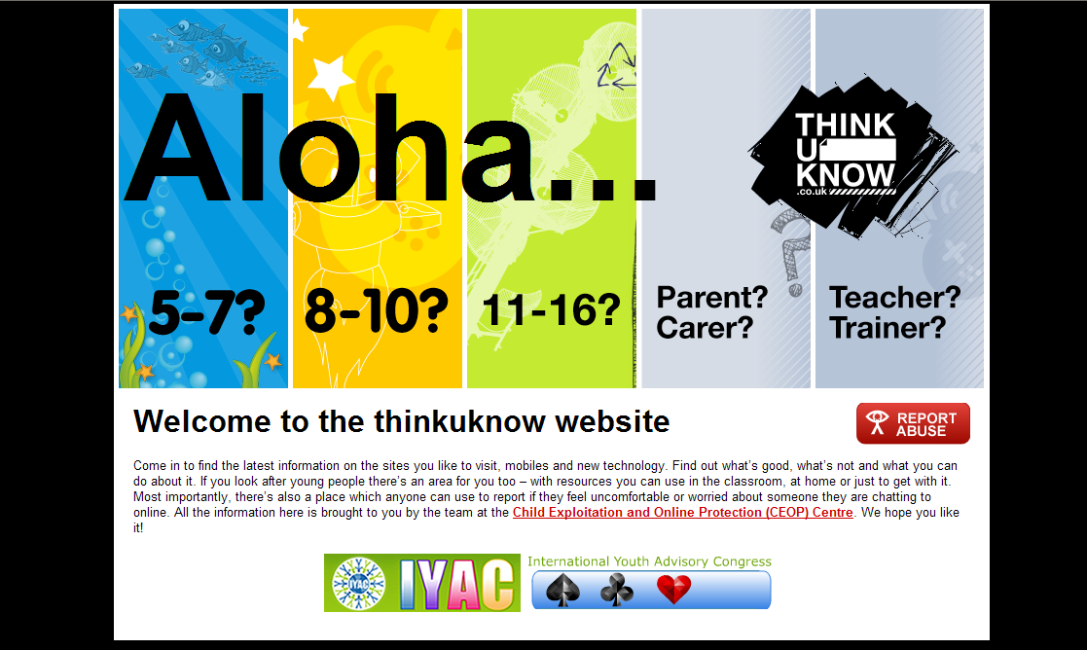

Reporting a Problem
www.thinkuknow.co.uk
Virtual Global Taskforce
Learn how to create a brochure using Microsoft Publisher

Slide 7
Tips to Stay Safe
Don’t give out your personal details
If you share a picture remember it can easily be changed
Don’t reply to SPAM
Remember people lie online
Don’t meet up with strangers without an adult you trust
Always report problems
Learn how to create a brochure using Microsoft Publisher

Slide 8
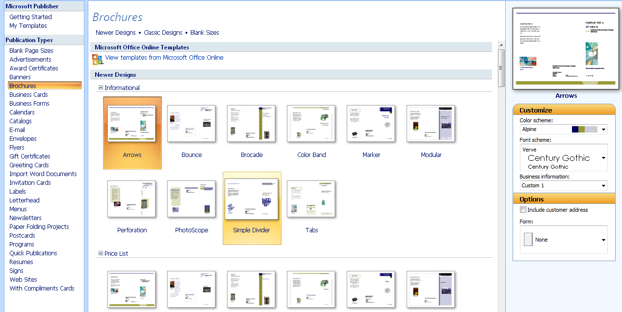
Creating a Brochure
Select Brochures from “Publication Types”
Customize it here!
Choose a style you like.
Learn how to create a brochure using Microsoft Publisher

Slide 9
Task
Create a brochure aimed at students of your age group telling them how to stay safe online. Start with the outside pages today:
Front page – Must be eye catching to make people want to open the brochure.
Back page – Use this to put an Internet Safety Quiz so readers can test their knowledge!
Information about you and the school goes here.
Learn how to create a brochure using Microsoft Publisher

Slide 10
Next Lesson . . .
. . . you will be creating the inside pages of your brochure.
Learn how to create a brochure using Microsoft Publisher

Slide 11
What can you remember?
What are the risks online?
What should you do if you have a problem online?
How do you report a problem?
Monday, 08 November 2010

