Slide 1

Year 8 ICT
Creating an Easter eCard

Slide 2
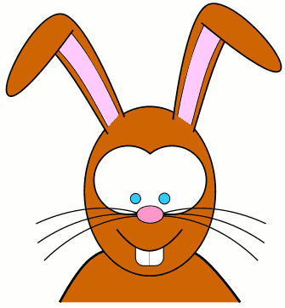
Today’s Learning Objective
“Learn how to create an Easter eCard using PowerPoint”.
Write this Learning Objective onto your Self Assessment Sheet.

Slide 3



It’s nearly Easter . . .

Slide 4

Time to get Eggcited!

Slide 5
Happy Easter Year 8
From
Miss Maddams!

Slide 6
Task
Create an Easter eCard like the one you have just seen to send to a friend or family member.
Make sure you put timings and animation into the eCard so it runs automatically.

Slide 7
Today’s Learning Objective
“Learn how to create an Easter eCard using PowerPoint”.
Put ☺ or ☹ onto your Self Assessment sheet to show whether or not you have achieved today’s learning
objective.

