Slide 1
Web Quest –

Slide 2
Today’s Learning Objective
“Learn how to carry out efficient searches using the Internet”.
Friday, 14 November 2008

Slide 3
Searching the Internet
Finding who was top of the premier league
Is this an efficient search?
Do we want to search the whole Internet?
Learn how to carry out efficient searches using the Internet

Slide 4
Results
HOW MANY RESULTS????
Are these results useful?
341,000 results! That’s a lot!
Learn how to carry out efficient searches using the Internet

Slide 5
Efficient Searching
Better way of searching:
Don’t write sentences – just key words!
Use “quotes” to keep certain words together when you search.
Only search for UK results
Learn how to carry out efficient searches using the Internet

Slide 6
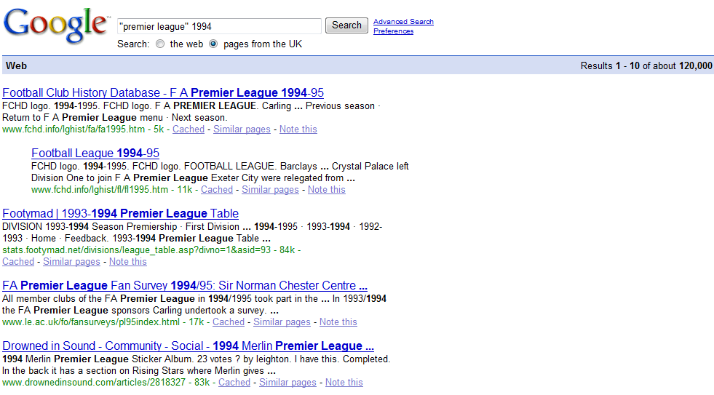
Results
Now look at the results . . .
More useful results.
Less than half the number of results. Only 120,000
Learn how to carry out efficient searches using the Internet

Slide 7
Tasks
Create a word document with the title:
Web Quest – Children in Need
Now find out the following:
When did Children in Need start?
What specific things does Children in Need raise money for?
Describe a child illness that Children in Needs gives money towards.
What is the phone number to make a donation?
List all of the songs that have been brought out to raise money for Children in Need in the last 10 years.
Learn how to carry out efficient searches using the Internet

